Slide 1

Time series Analysis
Mg Real Estate Group
By Omega Markos

Slide 2
Problem
MG Real Estate Group profit is becoming unpredictable
Low risk high profit investment

Slide 3
Methodology
Time series model:
To forecast future values ?
Risk factor analysis & filtering
Population growth
Job growth
Rent index
Vacancy rate
Model accuracy
Data preprocessing
Zillow data set 1996-2018
Identify zip codes with rapid price increase

Slide 4
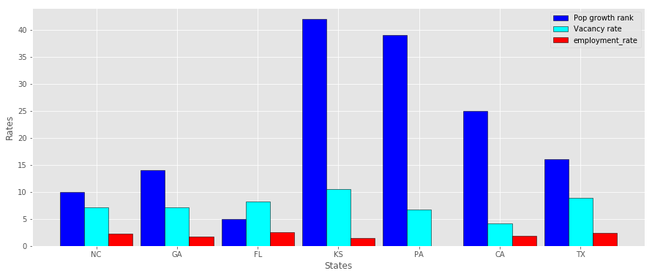
Factors affecting
real estate investment
Highest vacancy rate
Fast population growth

Slide 5
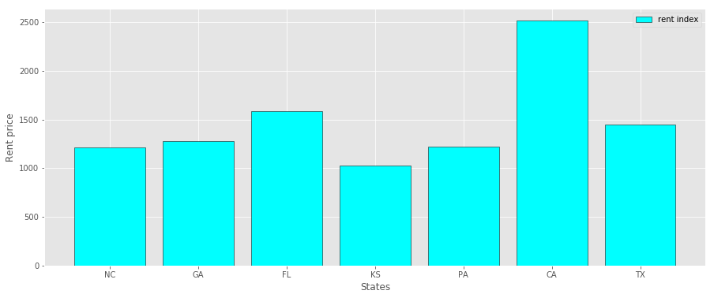
Factors affecting
real estate investment
Rent price by state

Slide 6


Recommended locations
Location | Rate of increase
Zip code 27980 Hertfold, NC | 45%
Zip code 30032 Candler-Mcafee,GA | 76%
Zip code 33805 Lakeland, Fl | 78%
Zip code 32117 Holly Hill,Fl | 56%
Zip code 28208 Charlotte, NC | 73%

Slide 7
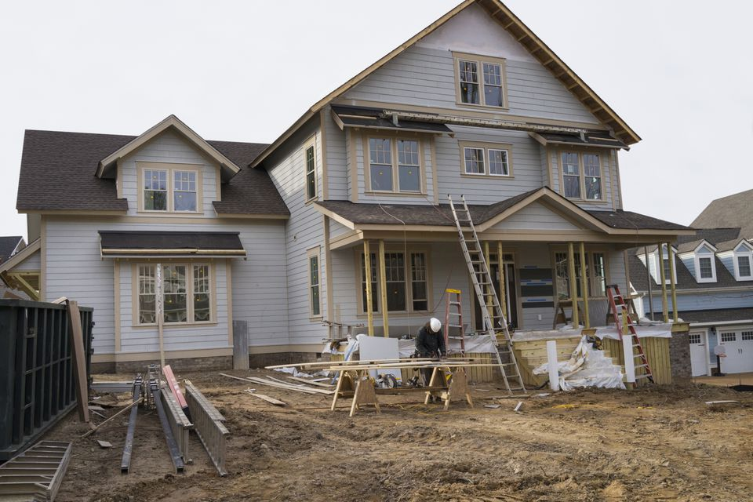

Recommendations
Flip & sale
Zip code 27980 Hertfold, NC
Zip code 32117 Holly Hill,Fl
Rent & sale
Zip code 32117 Holly Hill,Fl
Zip code 33805 Lakeland, Fl
Zip code 30032 Candler-Mcafee,GA

Slide 8

Future work
More analysis on the types of houses with in a specific zip code
Include the rent profit to the calculated ROI

Slide 9
Thanks!
Any questions?
Contact info
omegaghirmay@gmail.com

